Slide 1

Coeur D'Alene, Idaho
By: Nizan Howard
Notes:
-Population estimated of 55,904 as 2021
- most famous for it’s lake side ; a lot of people come here f or vacation, recreational activities and resorts
. – federal recorded Native American community who were known to live along the lake side

Slide 2
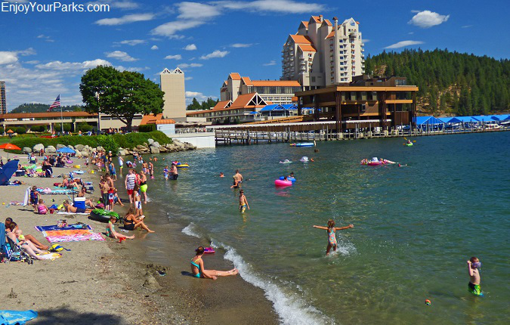
Tourism
Coeur D'Alene Idaho Lake
Coeur d’Alene Tribal activity estimated 330 million annually directly employing over 1,700 individuals.
Tourism and hospitality related jobs employed over 10,000 people in north Idaho in 2010.
Notes:
- Tribal Benefits Idaho’s economy 330 million according to Idaho Gov
Great growth due to it’s tourism
Tourism and hospitality related jobs Massive amount of jobs employment for over 10,000 ppl in 2010

Slide 3

Overall Focus :
Does smoke estimates impact Coeur D'Alene economy in jobs that rely on tourism?
Notes:
Data USA : in 2021 7.66 % of employment in Idaho was in the department of Accommodations and Food services
And 2.55 % were in Arts Entertainment, and Recreations
A total of 10.21 % of employment revolved around hospitality and tourism.

Slide 4

The Data:
NAICS 72:
Accommodation and Food Services
NAICS 71: Arts Entertainment and Recreation
Smoke estimate: ((Area) (Distance))**2
Notes:
I specifically looked into continuous variables under the US CENSUS BUREAU codes :
NAICS 7211: Traveling accommodation:
This incudes Hotels and Motels
Bed and breakfast INSS
- other traveler accommodations like Casinos,
- NACIS 71 : Is based on Entertainment and recreation :
- Includes Museums and Historical cites
- Amusement parks, arcades,
- Recreation industries

Slide 5
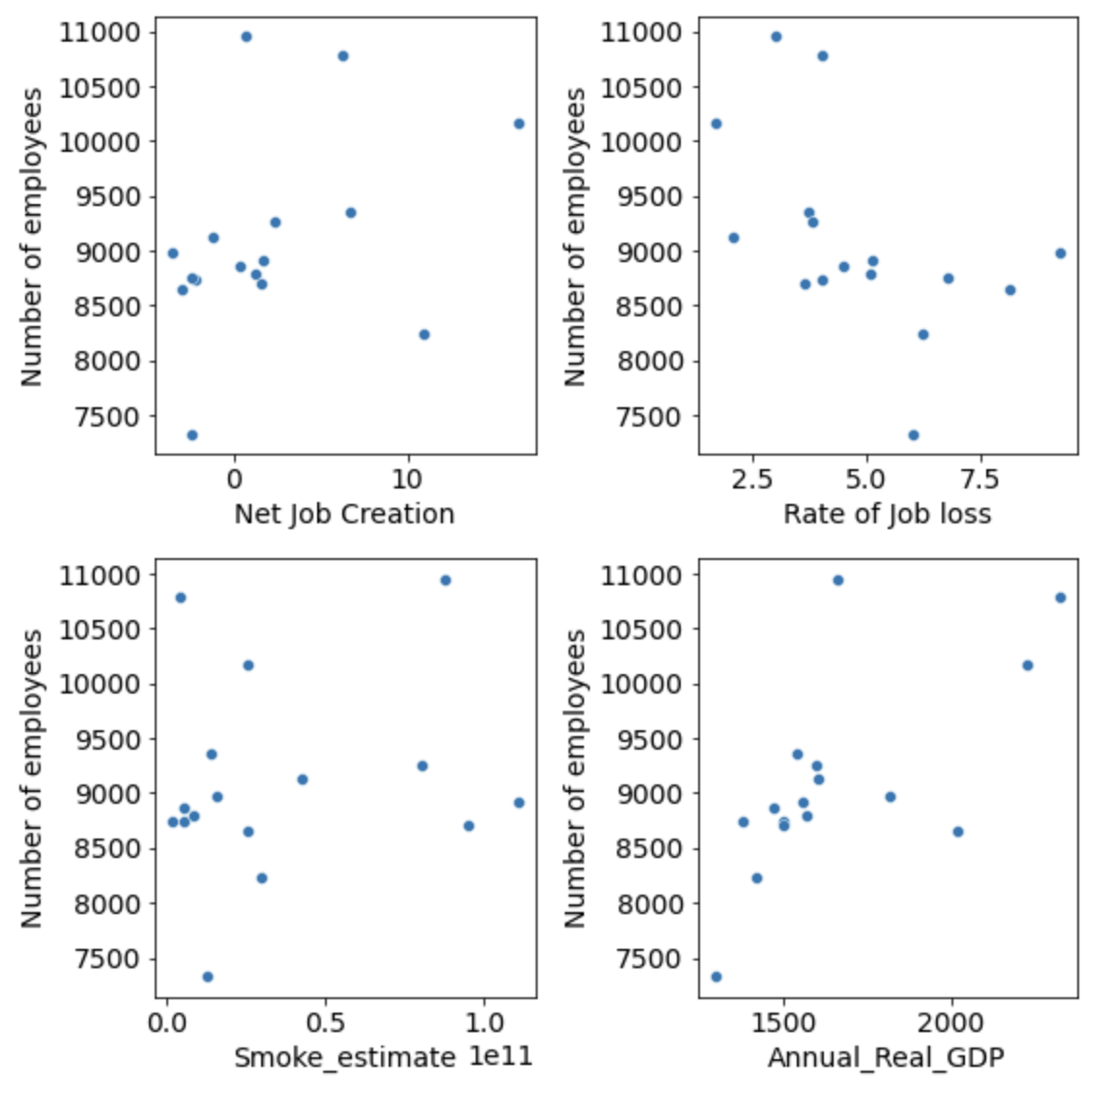
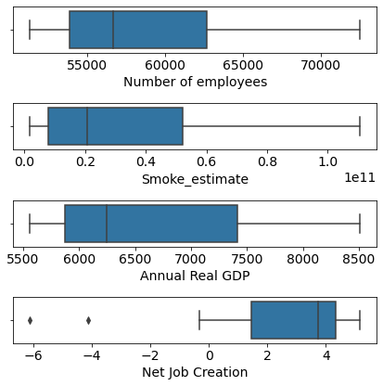
Exploratory Analysis
Notes:
In these two different topics using US Census Bureau Data:
I looked into
Number of employees in thousands
Annual Real GDP (Millions of Chained 2012 Dollars)
Net Job Creation rate taken in the last 12 months
Rate Job loss in the last 12 months
Smoke estimates
Between 2005-2020

Slide 6

Hypothesis 1:
Does smoke estimates impact the amount of employment for travel and accommodation jobs in Idaho?
Notes:
Using Multiple linear regression, I wanted understand :
Using the continuous variables:
- I set number of employees as a response to the predictors of job creation and loss rate, annual gdp, and my smoke estimate
To see if maybe any of my predictor variables may have a relationship and if smoke estimates does not have a direct relation
but the other predictors do to then test for an indirect relationship
-
-

Slide 7
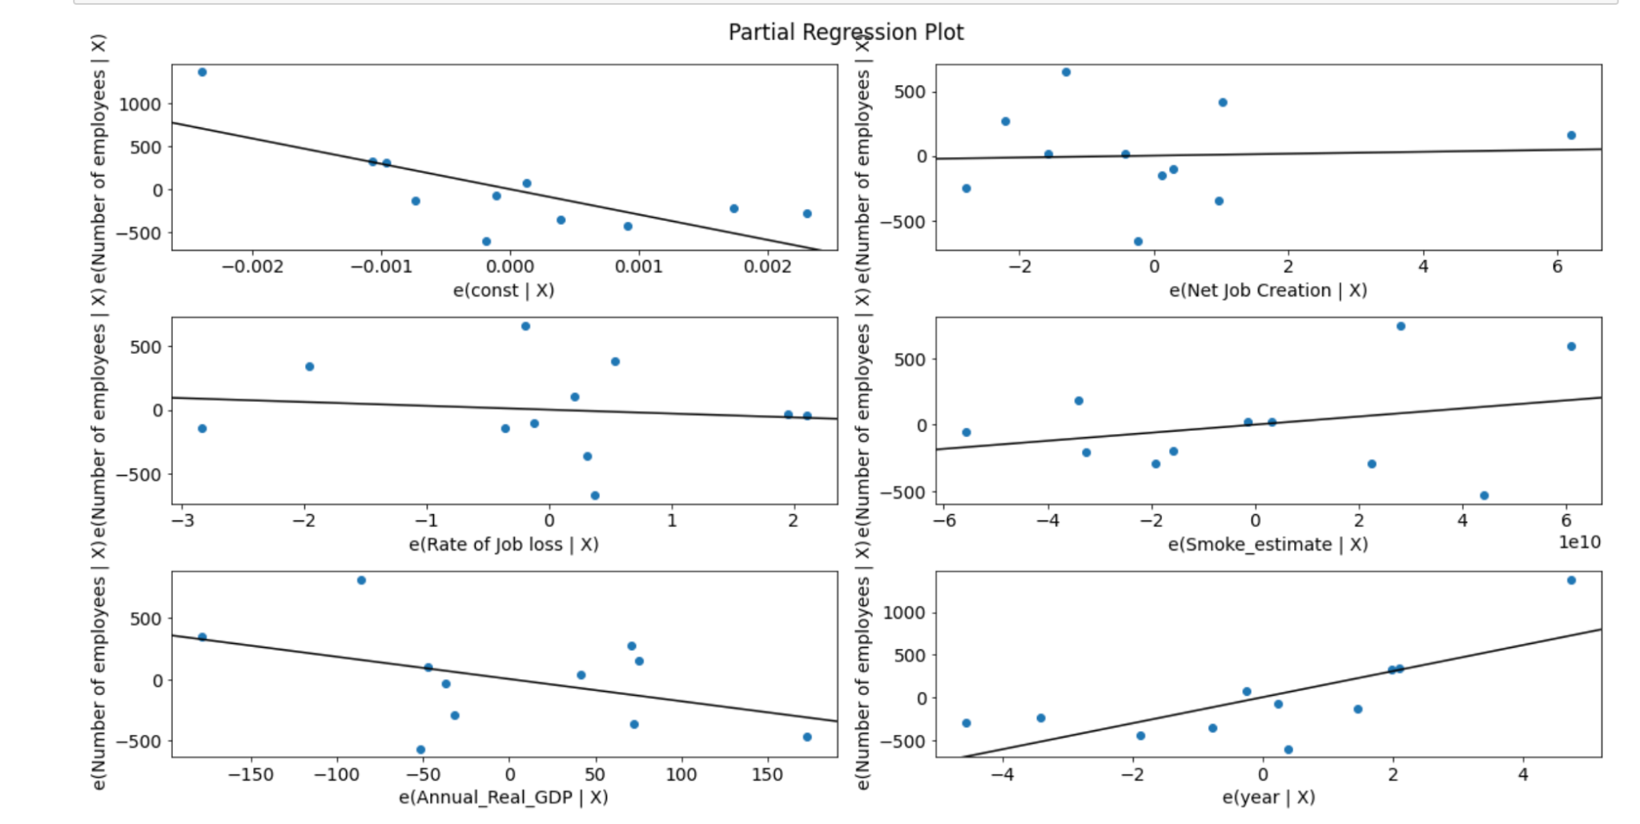
Results
R-squared: 0.60
Adj.R-squared: 0.4
Smoke_estimate :2.037e-09
P value: 0.135
Notes:
I found that r-squared : captures the percentage of strength in a relation was 0.60 but that increases with number of predictors
-the adjusted r-squared showed that there was not allot of actual effect the dependent variables as only 0.40
- Although there was not statical significance in smoke estimates found I did see the Real Annual GDP in millions did have a statistical significance

Slide 8

Hypothesis 2
Do smoke estimates impact the amount of employment for Entertainment and Recreation jobs in Idaho?
Notes:
Using Multiple linear regression, I wanted understand :
Using the continuous variables:
- I set number of employees as a response to the predictors of job creation and loss rate, annual gdp, and my smoke estimate
To see if maybe any of my predictor variables may have a relationship and if smoke estimates does not have a direct relation
but the other predictors do to then test for an indirect relationship

Slide 9
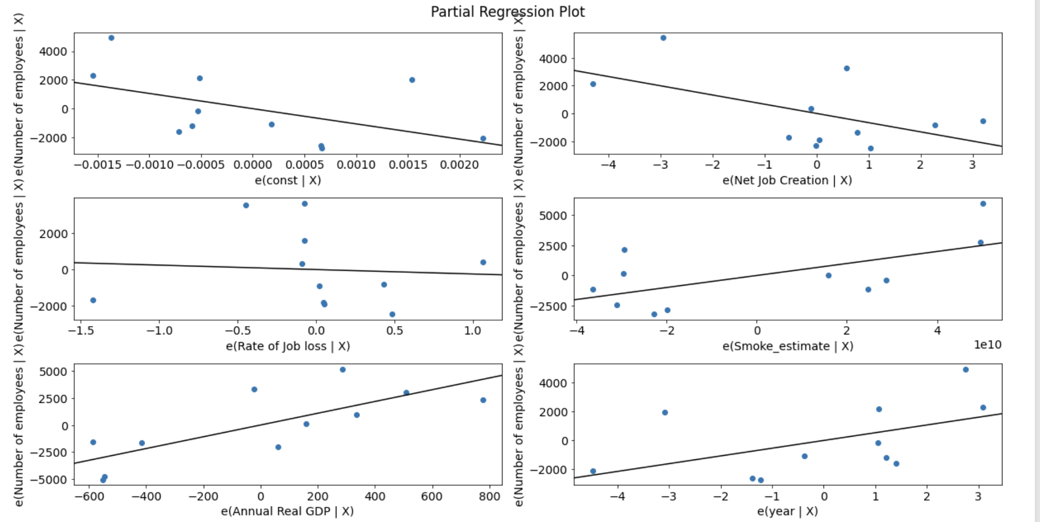
Results
R-squared: 0.682
Adj. R-squared: 0.364
Smoke_estimate :3.037e-09
P Value: 0.535
Notes:
I found that r-squared : captures the percentage of strength in a relation was 0.68 but that increases with number of predictors
-the adjusted r-squared showed that there was not allot of actual effect the dependent variables as only 0.364
- Although there was not statical significance in smoke estimates found I did see the Real Annual GDP in millions did have a statistical significance

Slide 10
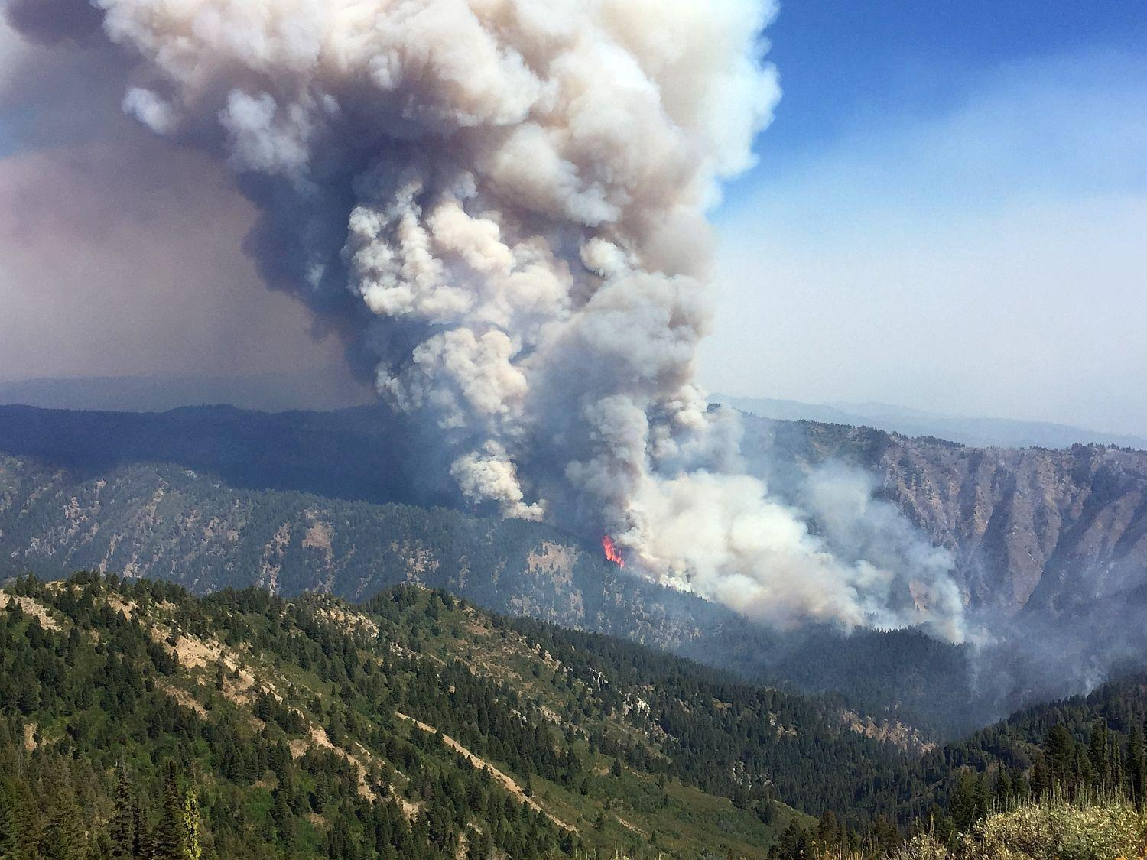
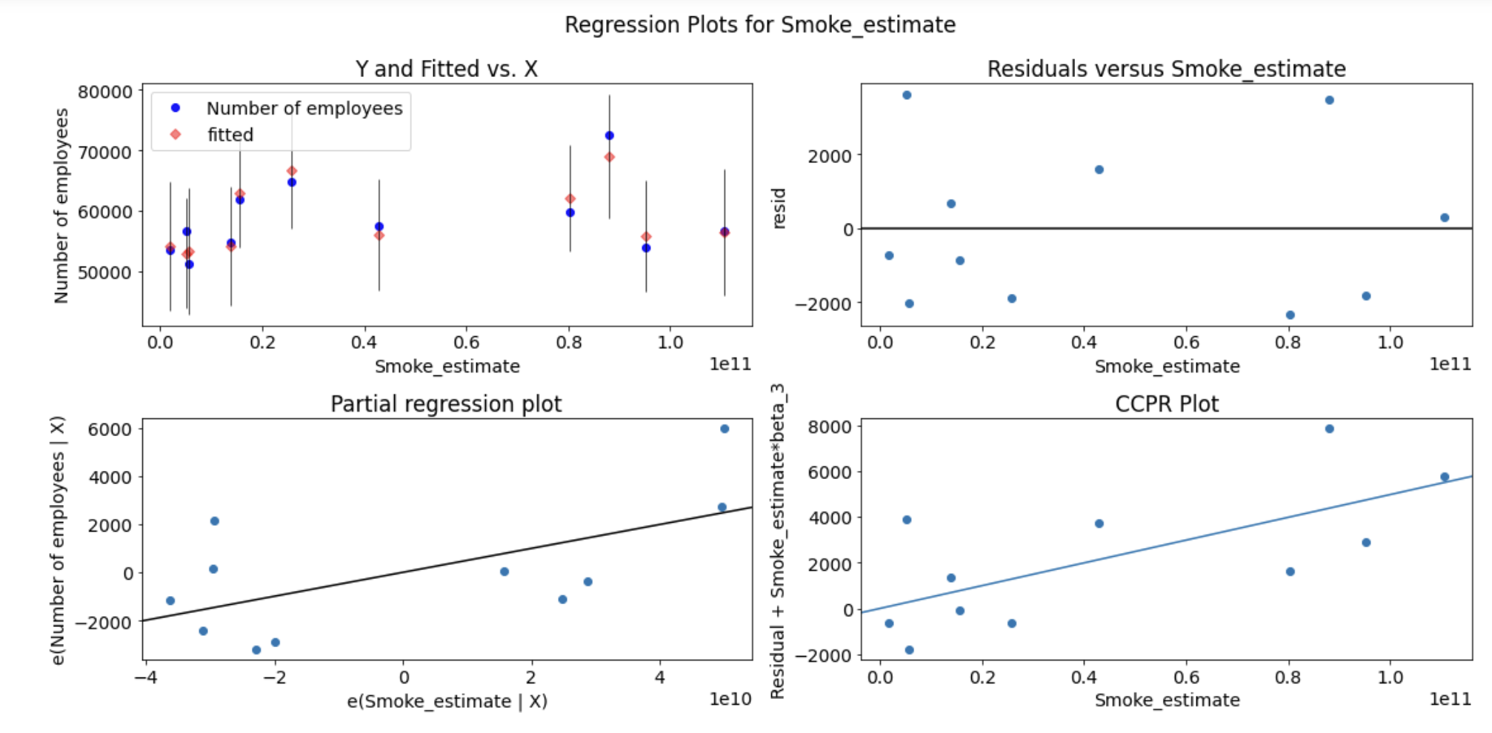
Impact and Meaning
Notes:
Example from NACIS in terms of NACIS 71 :
Component-Component plus Residual (CCPR) Plots
The CCPR plot provides a way to judge the effect of one regressor on the response variable by taking into account the effects of the other independent variables
My Residuals versus smoke estimates plot :
my residuals do not see to have a constant variance it is not normally distributed (with a mean of zero), and
be independent of one another.

Slide 11

Limitations and Expansion
Notes:
Limited to Linear assumptions that are showed :
have a constant variance nope
be approximately normally distributed (with a mean of zero), and
be independent of one another over time
Although that is not to say : Smoke estimation may not have an indirect impact on job employment :
I did see thar the Real Annual GDP did have an impact on the number of employer
It is import to include more research to explore whether smoke estimation may affect GDP that shows a correlation to employment
Overall, Job employment in tourism is important to Coeur De Alene, Idaho and research how smoke estimates may affect it is import to the economy of that city.

